Slide 1
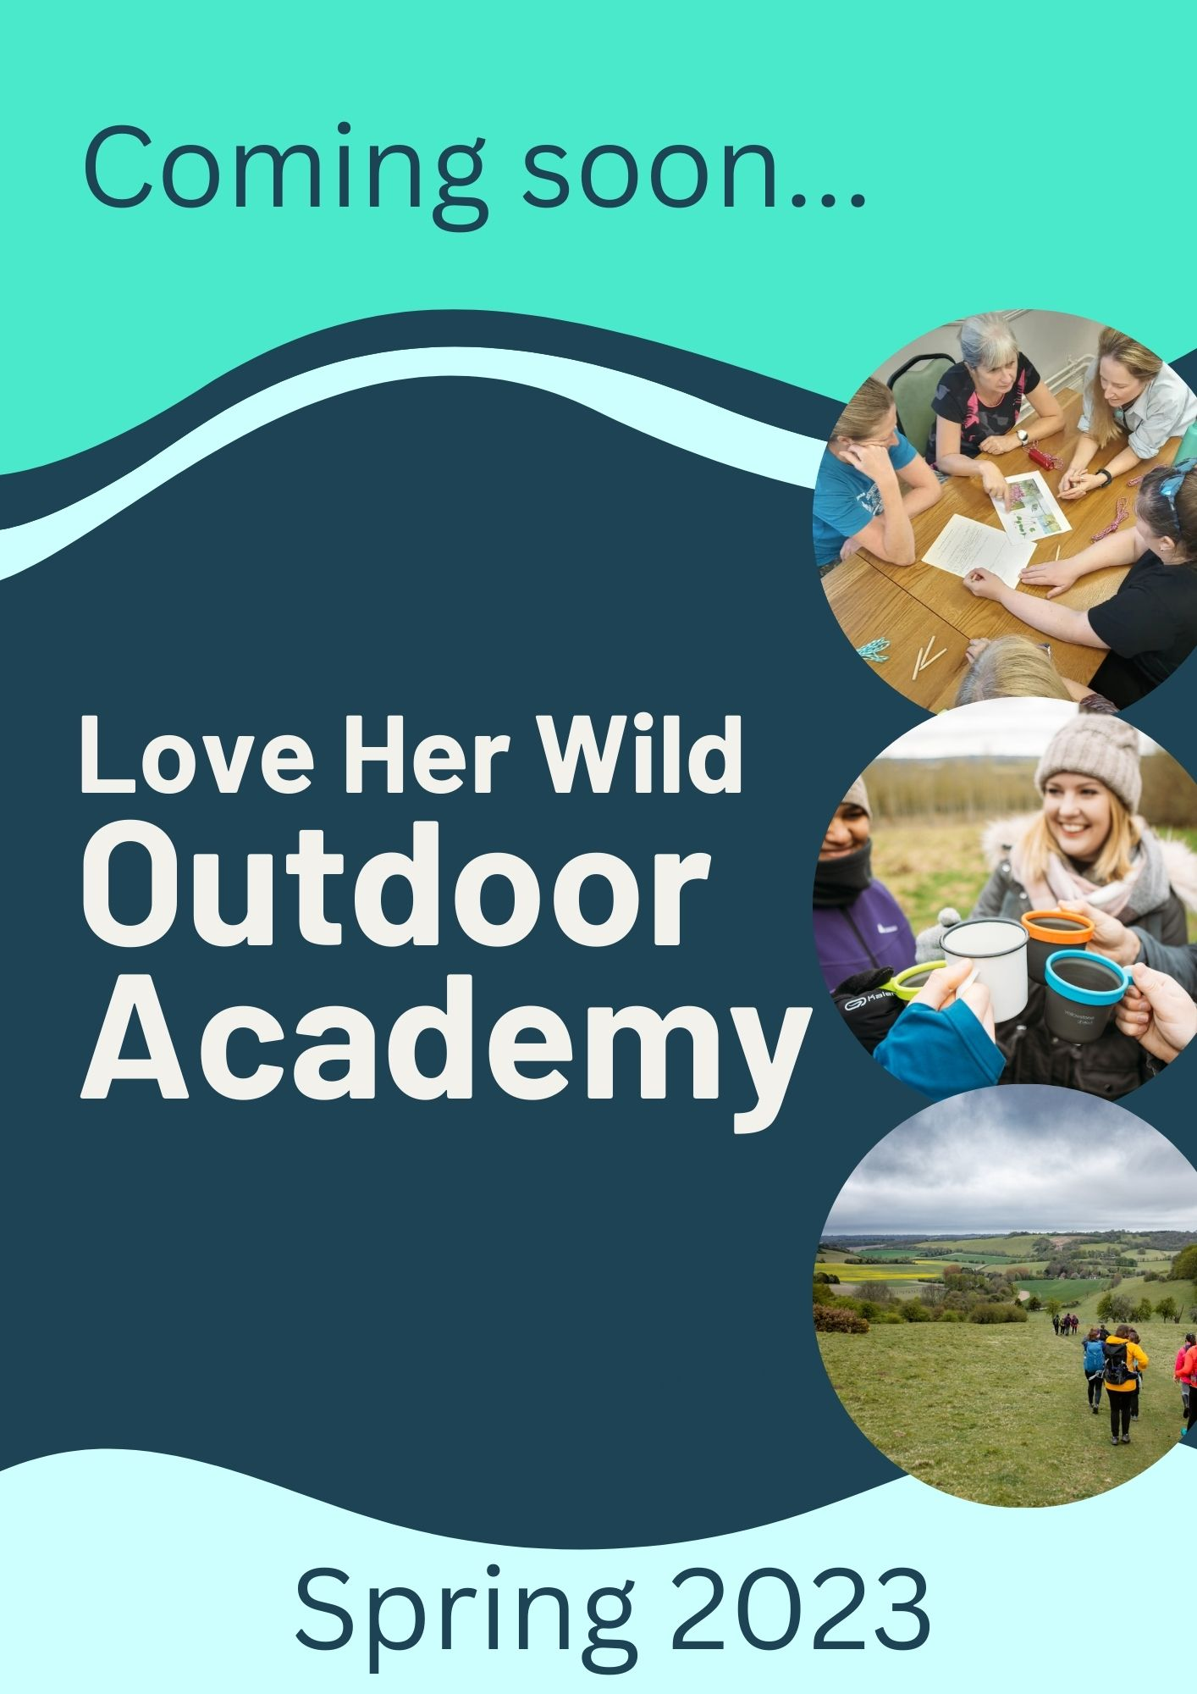

Slide 3
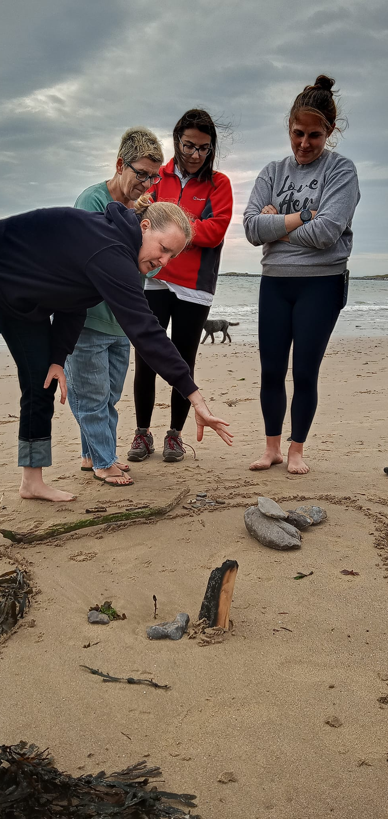
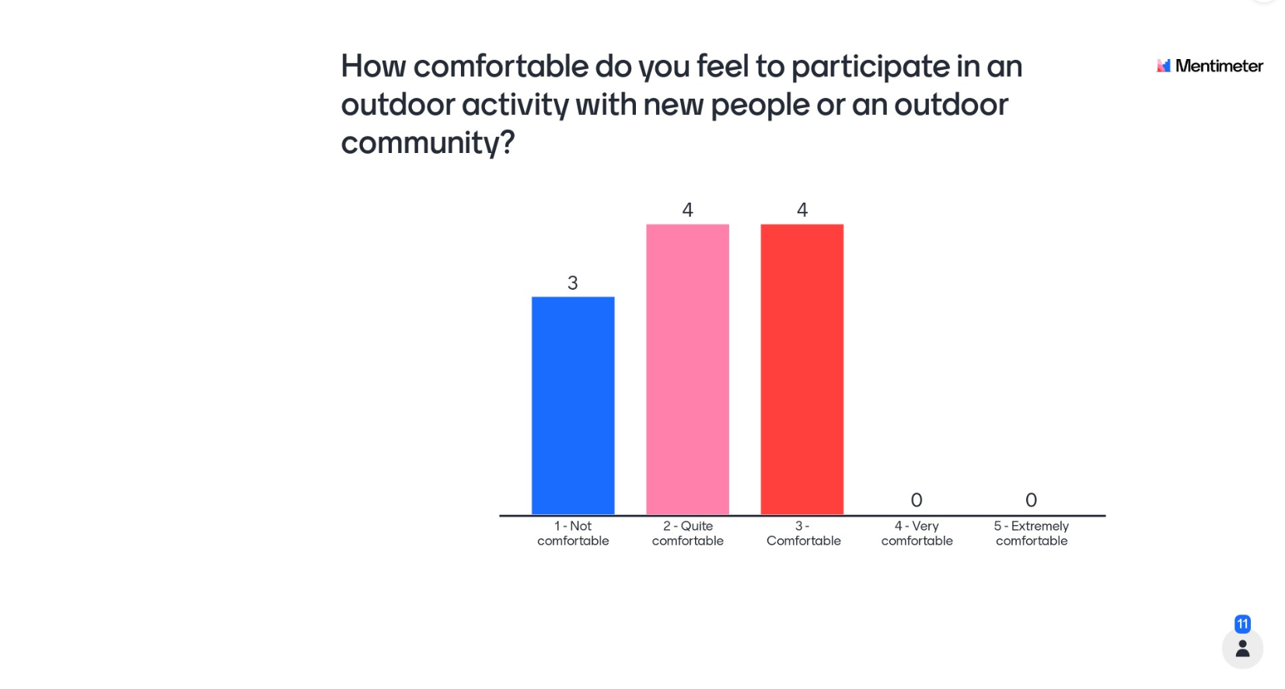

Slide 5
We haven't gone outdoors yet but everyone seems friendly and open to beginners
Why?
I said likely because I know I'd like too, I'm just nervous - so I'm hoping this weekend gets me past the nerves :)
They are well organised and very friendly - everyone helps if you need it
I would definitely be interested in going to more events, I guess I'd want to see how it goes and look at joining a local group near to afterwards
I’m v eager to find out more about the events and everyone seems friendly
I've a back/ leg problem that makes me worry I'll not keep up with a more experienced/ confident group. I will need to see how I get on with this group (and how much my slowness irritates everyone!).
I said likely because I feel positive about this upcoming event and I hope I enjoy it and get a taste for doing more outdoor activities.
I would be keen to attend a future event but worry about slowing the group down
I can hand on heart say I've never come across a supportive female only group in all my years of searching for outdoor walking groups. You are pioneers and absolutely great at what you do, the Relay Race was a prime example of that! You're a non judgmental, compassionate, and open group; an unsaid heroism!
I gave the response as it would depend on when the event is being held, I would definitely like to go to a future event though!

Slide 6
I’m not sure if I have outdoor specific skills
None really. I could probably contribute to cooking outdoors.
im not sure what outdoor skills i have, just enjoying nature and feeling connected to the earth.
Not many - though i do have o’level geography! and i do own a compass! I do like being outdoors
I've been foraging and on day walks but I've only been in a tent once 😅
I have the energy to hike, and move long distances. I have the ability to stay calm under pressure. I feel I have a good mindset for the outdoors; curiosity and willing to explore.
What outdoor skills do you have?
11 in total
I don't believe I have the outdoor skills, I would like; in particular the skills that would allow me to plan, navigate and get out there independently on a hike.
I am generally quite fit, and do sports and go to the gym, so I am comfortable walk for long periods.
A lot of camping experience on campsites. Cooking outdoors. Cheerful even when its pouring with rain
I've done some outdoor swimming and I walk my dog. Fine horse riding. Nothing particularly useful! But I'm good at listening and generally giving people confidence/ not panicking!
I don't think I have any other than enthusiasm and a willing to try

Slide 7
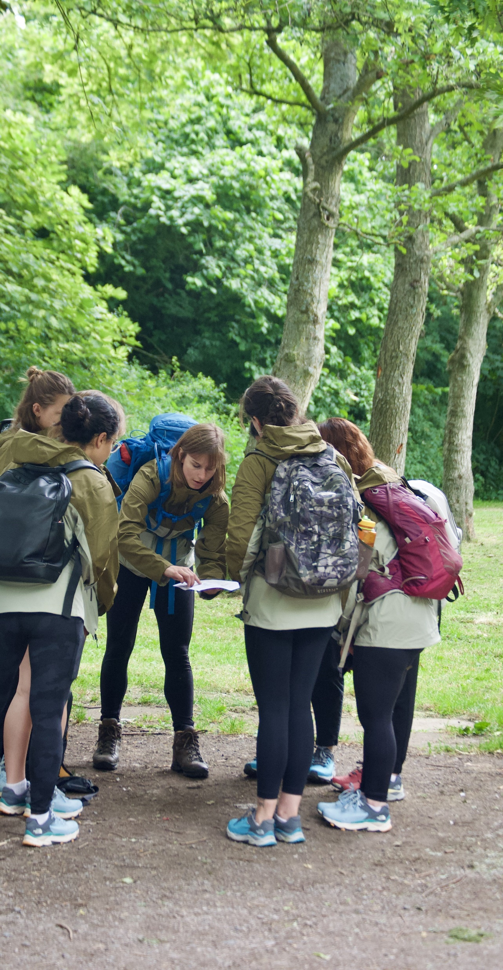

Slide 8
Girl guiding, love her wild, adventure queens
I don't really know any not since I did Duke of Edinburgh at school and Girl Guides.
20 total
The Ramblers, Cycling UK, Adventure Queens, local walking groups.
Not sure I do other than this one! I did do a short navigation course with The Nomad Pack, which was good and enjoyable
What organisations or communities do you know, that help you to make the most of the outdoors?
of course LHW!
I don’t know of any!
RHS, BHS, BD, Woodland Trust, National Trust
Local wild swimming groups
be well team in wigan, its a council run session where i would meet other mums for walks with our babies, ramblers, national trust
Ramblers, FB groups like Adventure Queens... we are thin on the ground with outdoor activities in West Yorkshire.
Not sure I know any - I know some other Facebook groups which is how I found out about this opportunity! I a, a part of ebony hikers and black girls hike. Aside from that, there’s a local group called steppers I believe

