Slide 3
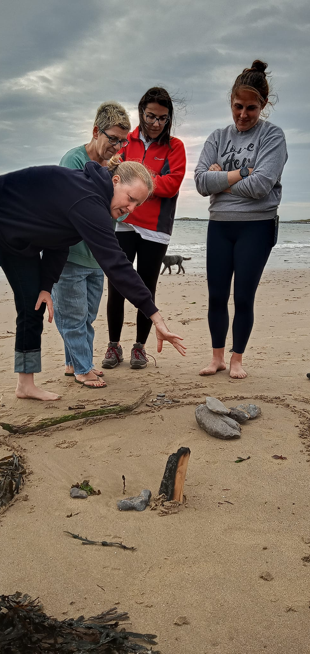

Slide 4
Comparison

Slide 6
Because Siân told me about one I want to go to because its close and accessible
Why?
More confident - doesn’t feel as overwhelming. Feels that I will be surrounded by others at similar levels of experience.
Casual yet well organized. Love doing new things and new people
Because I enjoyed the weekend and feel comfortable going to another event
Supportive community/people
There will always be a LHW event for me – maybe what I looked for in the outdoors has changed
There’s a large variety of events and this one was great
1) Travel costs 2) location/distance 3) do I have the kit?
Its seems like an inclusive environment . I’ll keep an eye on events and see what I can attend
I Because there is no reason why not and this weekend has given me the confidence to do it

Slide 7
Consideration for my companions
2 Equipment knowledge and packing
Willingness to try
Walking
10 putting up a tent
2 Outdoor swimming
3 Build a fire
Confidence in the outdoors – mindfulness and walking
2 Bird watching (visual/sound)
11 Navigation
2 Fitness levels (stamina/energy)
Horse riding
3 Toast marshmallows
What outdoor skills do you have? 26 in total!
Safety in the outdoors
Common sense!
Understanding of certain animal habitats
Spotting animal tracks
Aware of countryside code
2 Planning
Level of activity and distance
Patience
Team player
2 How to leave little or no trace
Problem solving/solution focused
2 How to use binoculars
Some survival

Slide 8
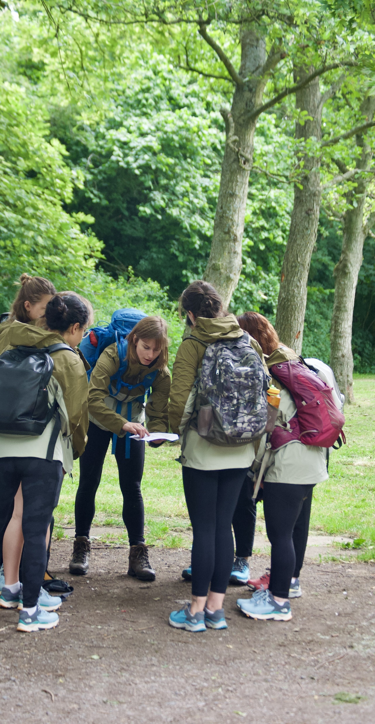

Slide 9
Love Her Wild
Wildlife Trusts
Forestry Commission
Woodland Trust
Rangers
Cinnamon Trust
Animal-specific organisations
Community officers
Bluetits
National Trust
1000 hours
Adventure Queens
Girlguides/scouts
RSPB
Mind
Leisure centres
Discover Your Outdoors
Alastair Humphreys
She Swims Falmouth
Women only walking groups
Steppers
21 total
What organisations or communities do you know, that help you to make the most of the outdoors?

